Slide 1
MFCS – Lecture 2
Dr. Padmalochan Bera
Associate Professor, CSE
School of Electrical and Computer Sciences
IIT Bhubaneswar
plb@iitbbs.ac.in

Slide 2
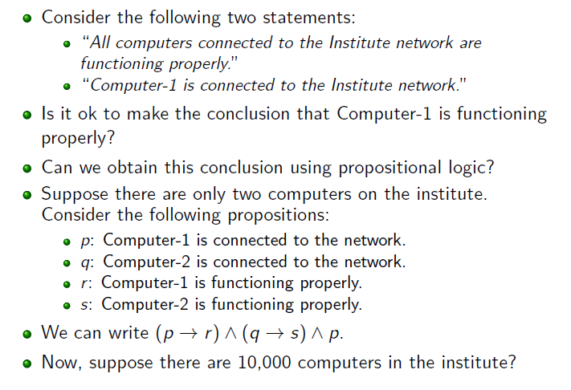
Lecture 2: Predicate Logic

Slide 3
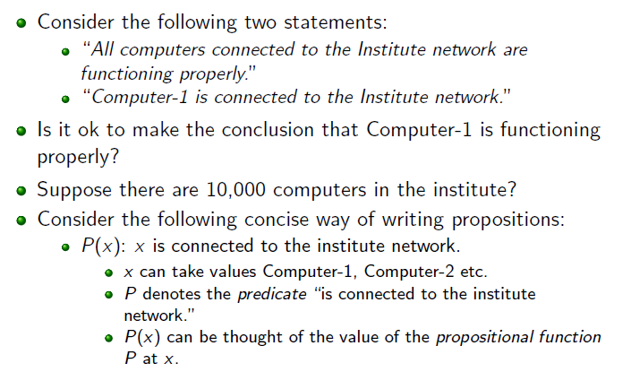

Lecture 2: Predicate Logic

Slide 4
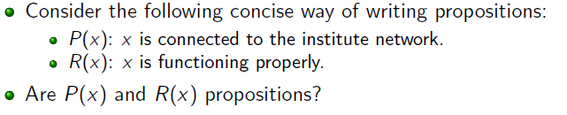


Lecture 2: Predicate Logic

Slide 5
Lecture2: Predicate Logic
Predicates:
Statements involving variables, such as
“x > 3,” “x = y + 3,” “x + y = z”
“computer x is under attack by an intruder”
/P(x): x is under attack/
“computer x is functioning properly”
x is subject variable
greater than 3 is the property the subject can have - predicate
Statement P(x) can be also said to be the value of the propositional formula P at x
Once value is assigned to x, P(x) becomes a proposition
P(4), P(2) are propositions with truth values T and F respectively

Slide 6
Lecture 2: Predicate Logic
a statement involving the n variables x1, x2, . . . , xn can be denoted by P(x1, x2, . . . , xn).
A statement of the form P(x1, x2, . . . , xn) is the value of the propositional function P at the n-tuple (x1, x2, . . . , xn), and P is also called an n-place predicate or a n-ary predicate.
Let Q(x, y) denote the statement “x = y + 3.” What are the truth values of the propositions Q(1, 2) and Q(3, 0)?

Slide 7
Lecture 2: Predicate Logic
Preconditions and Postconditions: Predicates are also used to establish the correctness of computer programs, that is, to show that computer programs always produce the desired output when given valid input.
Consider the following program, designed to swap the values of two variables x and y.
temp = x; /* P(x, y): x=a, y = b P(x, y): x > y
x = y;
y = temp; /*Q(x, y): x = b, y =a Q(x, y): x < y
Find predicates that we can use as the pre-condition and the post-condition to verify the correctness of this program.
Example : {x>-1} x := x * 2 + 3 {x > 1}

Slide 8
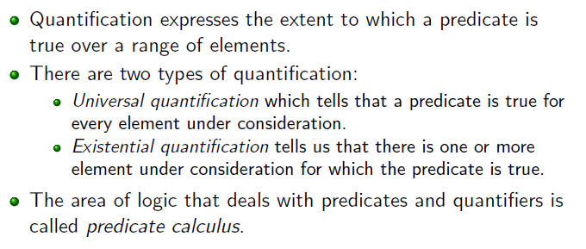
Lecture 2: Predicate Logic

Slide 9
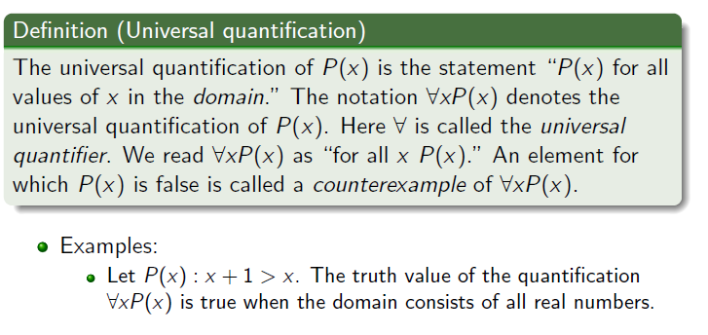
Lecture 2: Predicate Logic

Slide 10
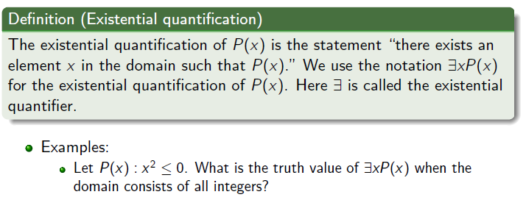
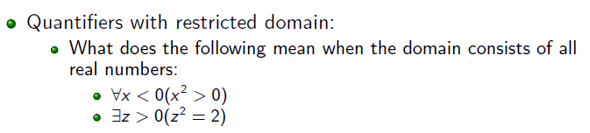
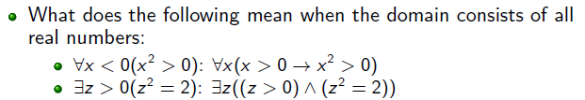
Lecture 2: Predicate Logic

Slide 11
Example
“The sum of two odd Integers is even.”
P(x): x is odd
E(x): x is even
(For all x belongs to Z), (For all y belongs to Z), p(x) ^ p(y) → E(x+y)
1, 2, -1,…
Y = 1, -1, 2, 0
Give an example of predicate P(x,y): x<y
Such that and have different truth values

Slide 12
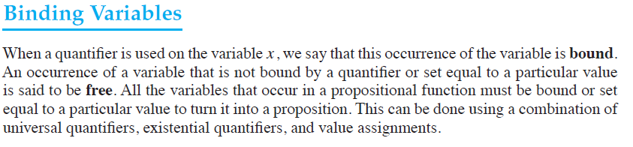
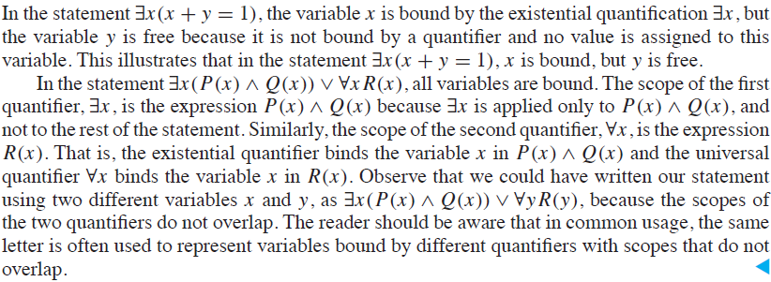
Lecture 2: Predicate Logic

Slide 13
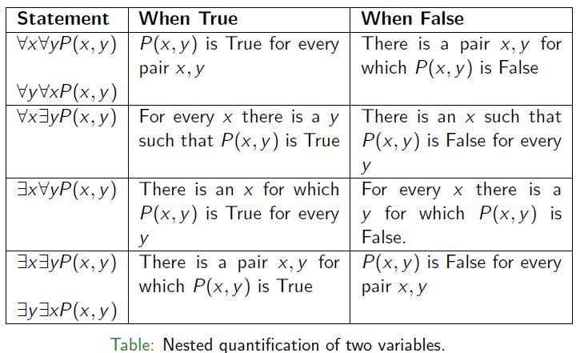
Lecture 2: Predicate Logic

Slide 14
existential x universal y P(x, y): x+y is even // F
universal y existential x P(x, y): x+y is even // T

Slide 15



Lecture 2: Predicate Logic

Slide 16
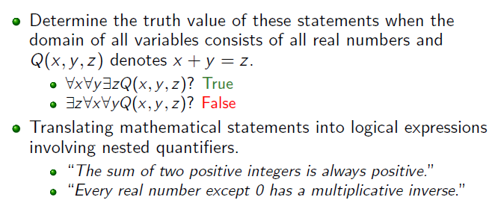
Lecture 2: Predicate Logic

Slide 17
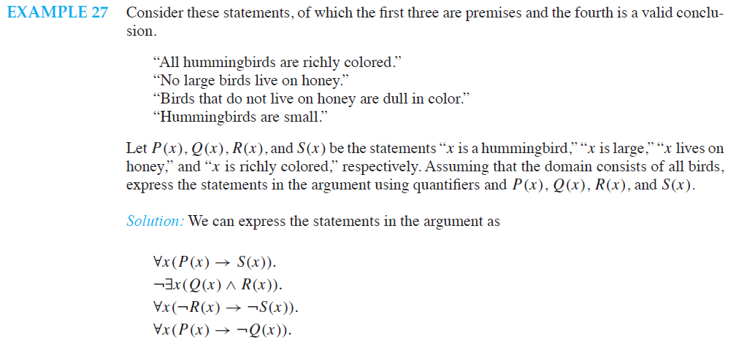
Lecture2: Predicate Logic

Slide 18
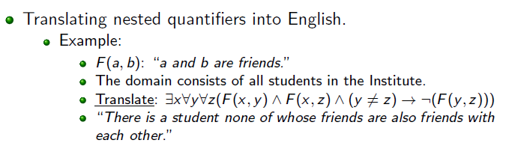
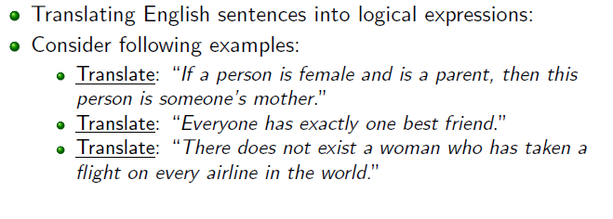
Lecture 2: Predicate Logic

Slide 19
Lecture 2: Rules of Inferences
Consider the following argument.
If you have a current password, then you can log onto the network.
You have a current password.
Therefore, you can log onto the network.
Is this a valid argument? Why?

Slide 20
Lecture 2: Rules of Inferences
Argument: A sequence of statements that end with a conclusion.
Valid argument: The conclusion must follow from the truth of the preceding statements (known as premises). An argument is valid if and only if it is impossible for all the premises to be true and conclusion to be false.
Rules of inference: Templates for obtaining new statements from already available statements or in other words templates for constructing valid arguments.

Slide 21
Lecture 2: Rules of Inferences
Let us write this argument more concisely.
Propositions:
p: You have a current password.
q: You can log onto the network.
Argument:
p → q
p
---------
q
We know that for any propositions p; q; r , ((p → q) ^ p) → q is a tautology. So, the initial argument is a valid.
Moreover, if we plug in any propositions into p and q such that the premises p → q and p are true for these propositions, then concluding q from these premises is a valid argument.

Slide 22
Lecture 2: Rules of Inferences
Definition (Argument and argument form): An argument in propositional logic is a sequence of propositions. All but the final proposition in the argument are called premises and the final proposition is called the conclusion. An argument is valid if the truth of all its premises implies that the conclusion is true.
An argument form in propositional logic is a sequence of compound propositions involving propositional variables. An argument form is valid if no matter which particular propositions are substituted for the propositional variables in its premises, the conclusion is true if the premises are all true.

Slide 23
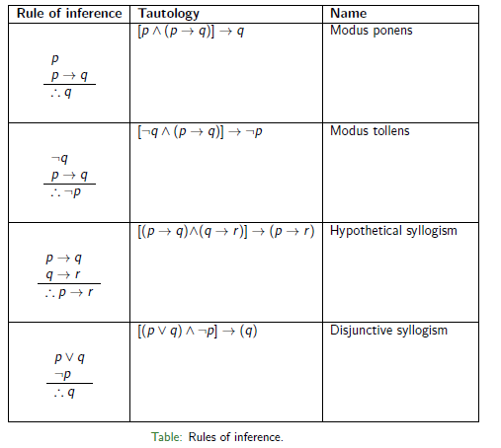
Lecture 2: Rules of Inferences

Slide 24
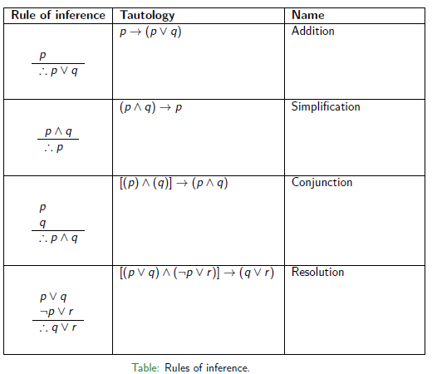
Lecture 2: Rules of Inferences

Slide 25
Lecture 2: Rules of Inferences
Which rule of inference is used in the argument:
If it rains today, then we will not have a barbecue today. If we do not have a barbecue today, then we will have a barbecue tomorrow. Therefore, if it rains today, then we will have barbecue tomorrow.
It rains today – p, we will have barbecue today – q, we will have barbecue tomorrow – r
p→neg(q); neg(q)→r; //premise//
p→r //conclusion// hypothetical syllogism; valid argument
Show that the hypothesis:
- It is not sunny this afternoon and it is colder than yesterday.
- We will go swimming only if it is sunny.
- If we do not go swimming, then we will take a canoe trip.
- If we take a canoe trip, then we will be home by sunset.
lead to the conclusion:
We will be home by sunset.

Slide 26
Lecture 2: Rules of Inferences

Slide 27
Lecture 2: Rules of Inferences

Slide 28
Lecture 2: Rules of Inferences

Slide 29
Lecture 2: Rules of Inferences

Slide 30
Lecture 2: Rules of Inferences
Show that the following argument is valid.
If today is tuesday, I have a test in Mathematics or economics. If my Economics Professor is sick, I will not have a test in Economics. Today is tuesday and my Economics Professor is sick. Therefore I have a test in Mathematics.
Show that the following argument is valid.
If Mohan is a lawyer, then he is ambitious. If Mohan is an early riser, then he does not like idlies. If Mohan is ambitious, then he is an early riser. Then if Mohan is a lawyer, then he does not like idlies.

Slide 31
Lecture 2: Rules of Inferences

Slide 32
Lecture 2: Rules of Inferences

Slide 33
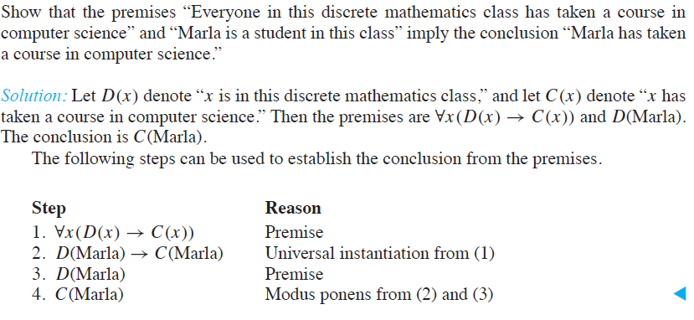
Lecture 2: Rules of Inferences

Slide 34
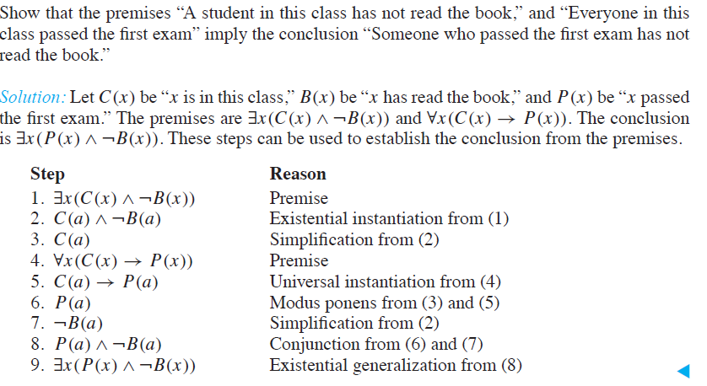
Lecture 2: Rules of Inferences

Slide 35
Lecture 2: Soundness
An argument will be sound iff it is valid and its premises are true.
Example:
1. All men are mortal
Socrates is a man
Therefore, Socrates is mortal
2. All organism with wings can fly
Penguins have wings
Therefore, Penguins can fly

Slide 36
Proof Techniques

Slide 37
Proof Techniques

Slide 38
Proof Techniques

Slide 39
Proof Techniques

Slide 45
Proof by Contrapositive
If x² – 6x + 5 is even then x is odd
If x is irrational then sqrt(x) is irrational

Slide 48
Proof by Contradiction
if n is an integer and n³+5 is odd, then n is even
For integers, a ! = 0 and b, there is only one number s.t ax+b=0 [i.e. if ax+b = 0 then for y != x, (ay+b) != 0]

